Slide 1
520 Final Presentation
Elevation-based navigation system (EleNA)
Notes:
We are team Java, here to present our initial plan of approach for project EleNA which is a Elevation-based navigation system.

Slide 2
Team Members - Group Java
Juie Jitendra Darwade
Arpita Singh
Veda Sree Bojanapally
Alok Kumar

Slide 3
The Problem
Navigation systems optimize for the shortest or fastest route. However, they do not consider elevation gain. Let’s say you are hiking or biking from one location to another. You may want to literally go the extra mile if that saves you a couple thousand feet in elevation gain. Likewise, you may want to maximize elevation gain if you are looking for an intense yet time-constrained workout. The high-level goal of this project is to develop a software system that determines, given a start and an end location, a route that maximizes or minimizes elevation gain, while limiting the total distance between the two locations to x% of the shortest path.
Stakeholders : Hikers, Mountaineers, Cyclers, Bikers
Non-functionalities requirements : Understandability, Readability, Testability, Portability, Usability, Modularity.
Functional requirements : Generate Map of city with elevation info, Apply Djikstra and A* algorithm to find shortest path routes, Plot route directions on UI.
Notes:
The reason why we choose this project is because it solves a unique problem for finding most optimal route for a given source and destination taking into consideration the elevation preference of the user. The most prominent use case would be for hikers or Biker for whom elevation gain is a crucial factor while selecting a route. Given a source and destination the application would provide user with an optimal path taking into consideration their elevation preference while limiting the path length to x% of the shortest path.

Slide 4
User Stories
As a user, I want to look at the elevation gain for a route between two locations.
As a user, I want to be able to choose whether to minimize/maximize elevation gain.
As a user, I want to be able to select location from a dropdown.
As a user, I want to be able to limit total distance to x% of the shortest path.
As a user, I want the route to be visible to me on a map.
As a user, I want the total distance and elevation calculated to be visible.

Slide 5
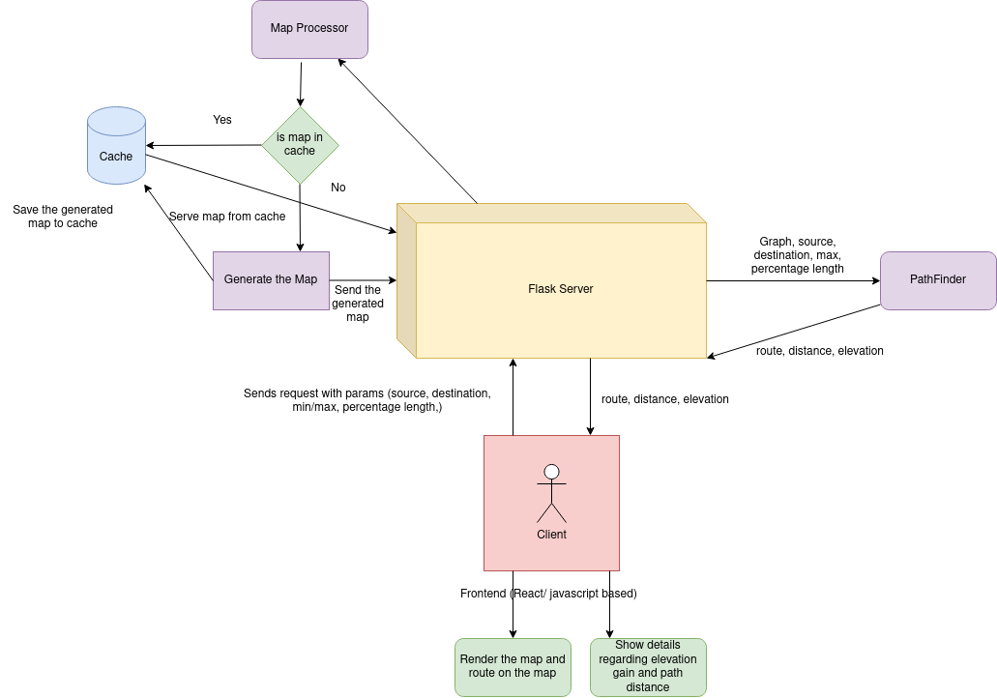
Architecture
Notes:
This represents the architecture of the project. Our project has a client server architecture in which the client is responsible for taking four inputs (source, destination, elevation preference of user and maximum percentage deviation from shortest path. Client will pass these inputs to the server which in turn will call MapProcessor module. Using these values MapProcess module will generate a graph around the geographical location of source and destination. It will also attach elevation values to each node. As graph generation is a costly operation, we will be caching all generated graphs. Now our serve will call PathFInder with the generated graph. PathFinder is basically an improvised version of standard Dijkstra or A* which will give the most optimal route taking user’s elevation preference into consideration. PathFinder will return geneated_route, distance of the route and elevation gain back to server.Server will return these parameters along with the generated map to the client. Client will be responsible for rendering the map on the UI and showing all the relevant informations like elevation gain etc to the user.

Slide 6
The Design
Client - Our client is written in Javascript, HTML and CSS. It is responsible for taking input from user in a form and sending the form data to the server. It also receives response from the server , renders a map and plots the route received from the server on the map.
Backend Server - Our backend server is developed in Flask. It receives input from the client and calls map generator to generate map for the specified city and state. It then calls pathfinder module to generate the most optimized route for the given user input. The generated map and optimized route along with elevation gain info is then sent back to client for frontend rendering.
Map Generator - Map generator module is responsible for fetching latitude and longitude for source and destination using Geocoding API from Google Maps Platform and generating map of input city and state using OSMnx library. Osmnx provides a method which attaches elevation data to each node of the generated graph using Open-elevation API . We have also introduced a cache that caches any newly generated maps to avoid redundant calls to the API.
PathFinder - PathFinder module is responsible for finding an optimized path for a given user input. The optimized path is found through a 2 step process. The path elevation based route using 2 algorithms - Dijkstra’s and A*. The module’s algorithm picker analyzes the output of both the algorithms and choses the one which is most aligned with the user’s preferences.
Notes:
Here we have given a brief description of various components from our architecture.

Slide 7
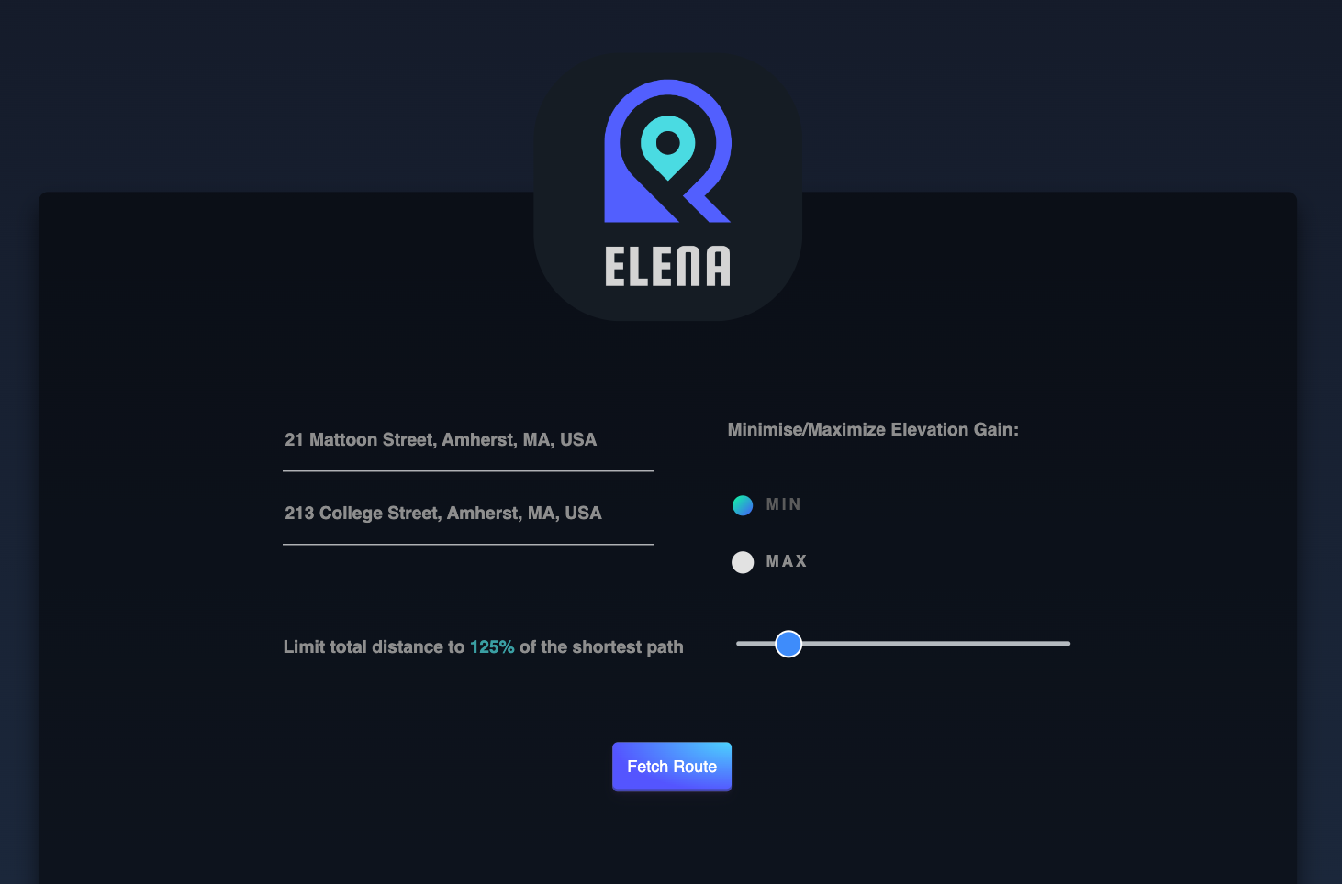
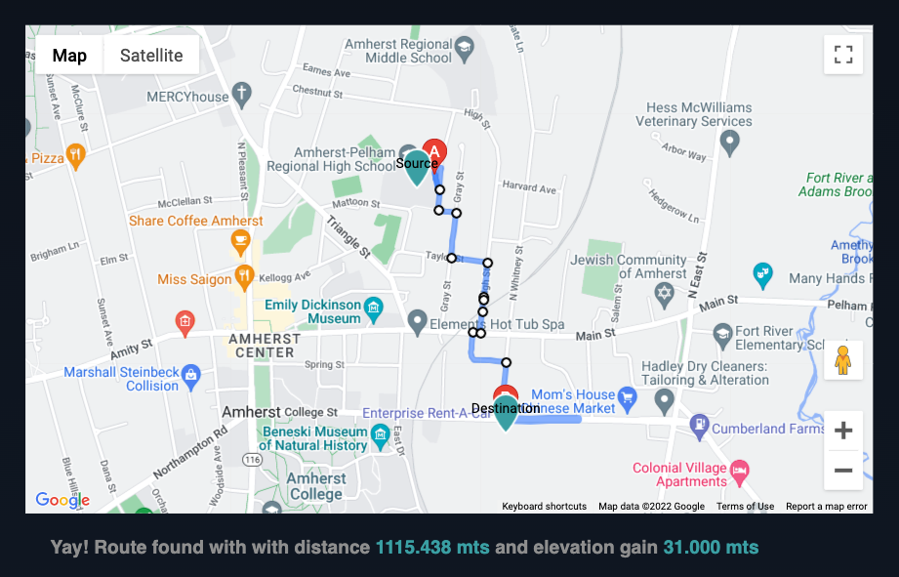
UI Design
Notes:
This represents the architecture of the project. Our project has a client server architecture in which the client is responsible for taking four inputs (source, destination, elevation preference of user and maximum percentage deviation from shortest path. Client will pass these inputs to the server which in turn will call MapProcessor module. Using these values MapProcess module will generate a graph around the geographical location of source and destination. It will also attach elevation values to each node. As graph generation is a costly operation, we will be caching all generated graphs. Now our serve will call PathFInder with the generated graph. PathFinder is basically an improvised version of standard Dijkstra or A* which will give the most optimal route taking user’s elevation preference into consideration. PathFinder will return geneated_route, distance of the route and elevation gain back to server.Server will return these parameters along with the generated map to the client. Client will be responsible for rendering the map on the UI and showing all the relevant informations like elevation gain etc to the user.

Slide 8
Tools and Methodologies
Backend - Python
Algorithms - Dijkstra and A*
Libraries and Frameworks - Flask, osmnx, Geocoding API from Google Maps Platform, Open Elevation API, Docker, Google Places API, Google Directions API
Frontend - JavaScript, HTML, CSS
Testing - pytest
Notes:
We will be using following tools and technology for our project. Our language of choice for this project is Python. We will be using Dijkstra or A* based path finding algorithm. We will be using Flask for our backend server. Osmnx for map generation , geopy for getting latitude and longitude of given source and destination and Google’s Eleveation APi to get elevation info. Out frontend would be either a react or HTML/ Javascript based application. We will be using pytest as our testing framework.

Slide 9
Testing
Unit testing :
Test edge cases
Validation checks on different inputs.
Tested PathFinder, MapProcessor and helper module individually.
We have used PyTest as our testing tool
Python logger is used as logging module for our project.
Manual Testing:
We tested our server using Postman using different locations and scenarios.
We tested edge cases and error situations manually as well.
Integration test:
End-to-end testing for all components together
Testing frontend and backend together with different scenarios and edge cases.
We are using integration test suite runner of Postman to run our integration tests.
Edge Case Evaluation/Error Situations:
Our map will only support sources and destinations lying within the same state.
Map Generation generates only map of the state entered.
Our client does not send a server request in case of wrong field entries and shows error messages appropriately.
UI testing:
For UI testing, we made 2 frontends, and asked our peers to try our application and give feedback on the UI elements. We also asked them about our design choices and if they liked the way our UI looked. A friend of ours suggested the slider percentage changer which we changed after the feedback, it was a number field before.

Slide 10
Interesting Features of our Application
We are calculating route using both algorithms, Dijkstra and A* and then our algorithm picker chooses the optimized route from the routes returned by the two algorithms.
We have also integrated Google’s Place Autocomplete API to facilitate adding source and destination for the user and produce correct results.
Our server is deployed on Heroku and frontend is deployed on Netlify for easier access. Apart from running our application on your local machine, you can also access our application here : https://sensational-squirrel-4f30da.netlify.app/
We have also deployed our application’s detailed documentation here : https://cute-donut-3ca29f.netlify.app/
We have also provided a docker image for our application to make it machine independent and easier to set up. You can access it here: https://hub.docker.com/repository/docker/alokrkmv12/elena_server
Our code repository : https://github.com/alokrkmv/project_EleNA

Slide 11
Member Contribution
Arpita Singh - Client
Alok Kumar - Path Finding, Deployment
Juie Jitendra Darwade - Map Generation
Veda Sree Bojanapally - Backend Server and Integration
Everyone - Testing, Evaluation , Presentation, Video and Documentation

Slide 12
Thank You!

